Slide 1


Categories and Concepts
[Professor Name]
[Class and Section Number]
Notes:
Classroom Recommendations: This PPT is presented in one 50 to 60-minute class period. However, if you would like to expand this to more than one class period, there is more than enough information contained in the module to cover over two class periods. Please also refer to the Instructor Manual that accompanies this PPT.
Overview: People form mental concepts of categories of objects, which permit them to respond appropriately to new objects they encounter. Most concepts cannot be strictly defined but are organized around the “best” examples or prototypes, which have the properties most common in the category. Objects fall into many different categories, but there is usually a most salient one, called the basic-level category, which is at an intermediate level of specificity (e.g., chairs, rather than furniture or desk chairs). Concepts are closely related to our knowledge of the world, and people can more easily learn concepts that are consistent with their knowledge. Theories of concepts argue either that people learn a summary description of a whole category or else that they learn exemplars of the category. Recent research suggests that there are different ways to learn and represent concepts and that they are accomplished by different neural systems.
Technical Note: These slides may contain simple click animation so that you can focus students’ attention on a particular question, a selection of text, or an image and not have them be distracted by reading ahead. You can either preview the sequence of animation by going through the slides in slideshow view, visiting the animations tab, or reviewing the slide notes. In the notes you will see a cue - (Click) – that corresponds to each animation.
You may also find hyperlinks to outside videos at various places in the slides. These hyperlinks are embedded in text and indicated by color and in the notes section.

Slide 2
Learning Objectives
Understand the problems with attempting to define categories.
Understand typicality and fuzzy category boundaries.
Learn about theories of the mental representation of concepts.
Learn how knowledge may influence concept learning.
Notes:
This slide is meant to let the students know the learning objectives of this lesson.

Slide 3
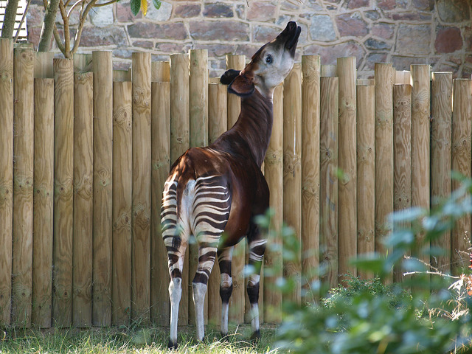
Warm Up: What is this?
What defines a zebra?
What defines a giraffe?
What is this?
Notes:
The purpose of this activity is to introduce the lesson by having students experience category and conceptual formation. It should take about 5 minutes and no materials are necessary.
Directions:
(Click): What defines a Zebra? (Have students give three or four characteristics of a Zebra.)
(Click): What defines a Giraffe? (Have students give three or four characteristics of a Giraffe.)
(Click): What is this? (You will show them four pictures of giraffes and zebras. Then you will show them a picture of an Okapi ask them what it is?)
(Click): This is a picture of a zebra
(Click): This is a picture of a giraffe
(Click): this is a picture of a zebra
(Click): This is a picture of a giraffe
(Click): This is a picture of an okapi. Now as students how it is similar and dissimilar? Then explain how constructing concepts and categories can be difficult and intricate.
Instructor’s note: For more information on the okapi, please visit https://en.wikipedia.org/wiki/Okapi
Discuss how they determined the category and how their reasoning relates to what they will be learning about in the class.

Slide 4
Overview
Introduction
Definition of category and concept
Fuzzy Categories
Source Typicality
Category Hierarchies
Theories of Concept Representation
Knowledge
Notes:
The purpose of this slide is to provide students with an overview of the material that will be covered during the lesson.
Content: What is the difference between a category and a concept? Categories help us learn and remember information by connecting several concepts that have similar characteristics. For example, the category of dog has many different types but share similar commonalities (e.g., canine teeth, mammals, hair of some sort, 4 toes, etc.). Whereas a concept is the mental representation of those categories. Sticking with the dog example, let’s say a person who grew up with working cattle dogs such as Border Collies, Australian Shepherds, and Queensland Blue Heelers. These types of dogs are that person’s mental representations for dog because of their experience with them. More on the nuanced differences between categories and concepts will be discussed below.

Slide 5
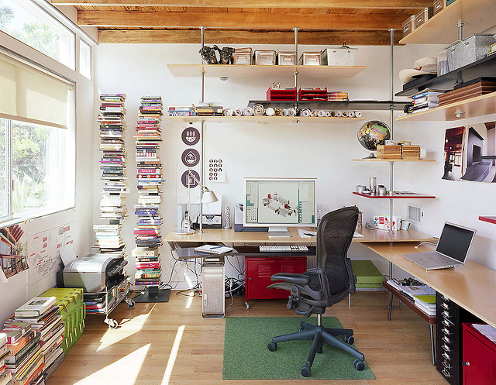
What is a Category?
Categories are…
Well-defined?
Contain necessary features
Jointly sufficient
What defines office furniture in the picture?
Notes:
The purpose of this slide is to describe and define the nature of categories.
(Click) Discuss and define categories.
(Click) Discuss that categories are thought to be well defined. But not always ☺
(Click) Discuss and define necessary features.
(Click) Discuss and define that categories are jointly sufficient.
(Click) Have students try to define the category of office furniture by identifying necessary features that are jointly sufficient.
Content: It has historically been thought that categories are well-defined with necessary features that are jointly sufficient for membership. Meaning, a category was clear cut with features that were in all examples of the category. For example, a dog is a four-legged animal that barks. However, you can see that this is not always the case.

Slide 6

What is a Concept?
Your mental representation of a category
Write down your concept of office furniture
Notes:
The purpose of this slide is to define and describe a concept.
(Click): Concepts are mental representations of the category.
(Click): Have students give an example of their concept of office furniture. Have them write it down and see how they differ across students. Then discuss how concepts can be idiosyncratic and depend on personal experience.

Slide 7
Overview
Introduction
Fuzzy Categories
Borderline items
Typicality
Prototype
Source Typicality
Category Hierarchies
Theories of Concept Representation
Knowledge
Notes:
The purpose of this slide is to provide students with an overview of the material that will be covered during the lecture

Slide 8
Fuzzy Categories Activity
In groups of 2-3, sort the words into two categories.
Be prepared to share your categorization.
Chair
Orange
Banana
Desk
Lamp
Pineapple
Bookcase
Pear
Watermelon
Table
Strawberry
Couch
Notes:
The purpose of this slide is to introduce and demonstrate the nuanced and sometimes arbitrary nature of categorizing information and how those categories can be truly fuzzy. Refer to the Activities/Demonstrations section for a detailed description of how to do this activity. It should take no longer than 5-10 minutes.
Tell students In groups of 2-3, I would like you to sort the words (e.g., chair, orange, banana, desk, lamp, pineapple, bookcase, pear, watermelon, table, strawberry, couch) to the right into two categories. Let students know that they will need to share their categories with the class.
(Click): Show them the list of words to categorize.
Ask students what their categories where. Students should easily categorize the first list into fruit and furniture.

Slide 9
Fuzzy Categories Activity
In groups of 2-3, sort list into fruits and vegetables.
Then share your categorization with the class.
Orange
Date
Olive
Cucumber
Pear
Plum
Strawberry
Pineapple
Tomato
Zucchini
Avocado
Pepper
Pumpkin
Peas
Notes:
The purpose of this slide is to introduce and demonstrate the nuanced and sometimes arbitrary nature of categorizing information and how those categories can be truly fuzzy. Refer to the Activities/Demonstrations section for a detailed description of how to do this activity. It should take no longer than 5-10 minutes.
Tell students In groups of 2-3, I would like you to sort the words to the right into two categories. Let students know that they will need to share their categories with the class.
(Click): Show them the list of words to categorize.
Ask students what their categories where. They may easily separate them into fruit vs. vegetables. However, they are all fruit (e.g., a tomato is a fruit). You should then introduce and discuss what makes some categories fuzzy.

Slide 10
Fuzzy Categories
What is the most typical bird you can think of?
What about this?
Borderline items
Typicality
Prototype
Notes:
The purpose of this slide is to define and describe fuzzy categories.
(Click): Ask students what their prototypical bird is. They will likely say robins, sparrows, etc.
(Click): Then ask them about the three pictures (crested penguin, Guianan cock-of-the-rock, and a platypus). Ask them how they are similar and different. Are they typical? Are they borderline?
Content: Categories can be fuzzy and unclear. For example, is a tomato a fruit, gourd, or a vegetable? Research suggests that there a number of borderline items/members of categories that we cannot agree on and we even change our categorization of these items over time. Another contribution to fuzzy categories is typicality. By example, what is the most typical bird you can think of? Is it a roadrunner, turkey, or an osprey? Probably not. Likely it is a robin or sparrow because these are more common and typical of the bird category and are considered the prototypical bird. The farther away from the prototype in characteristics, the easier the example becomes a borderline member (e.g., fuzzy category).

Slide 11
Overview
Introduction
Fuzzy Categories
Source Typicality
Family resemblance theory
Category Hierarchies
Theories of Concept Representation
Knowledge
Notes:
The purpose of this slide is to provide students with an overview of the material that will be covered during the lecture.

Slide 12
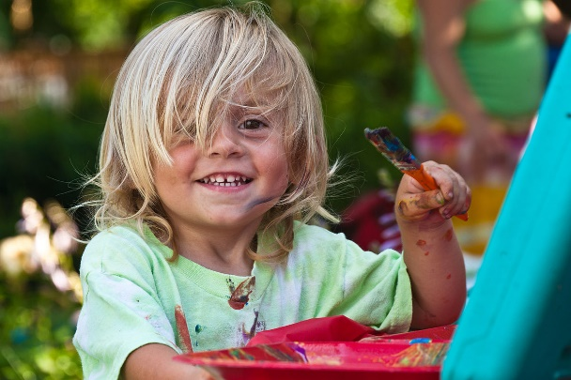
Source Typicality
Family resemblance theory
How are humans different from other species?
What similarities and differences do humans, ravens, and chimpanzees have?
Notes:
The purpose of this slide is to define and describe source typicality
(Click): Discuss family resemblance theory.
(Click): Ask students to discuss how humans are different than other species and relate their answers to family resemblance theory. The students may answer that two are mammals and one is a bird. They may connect that all of them use tools and are problem solvers. Use the conversation and their answers to illustrate this theory.
Content: What causes something to be a prototypical example of a category? Research suggests that it has a lot to do with frequency (e.g., how often you encounter the prototype) but has more to do with family resemblance theory. This theory suggests things are typical because they are frequent, yes, but also because they do not have features that are common in other categories. For example, robins migrate, fly, sing, hop around whereas penguins, don’t fly, less common, swim, wings look like flippers, etc. Typicality can influence how we process information (e.g., cognition). For instance, for prototypical examples, we categorize them faster, learn them before atypical examples, understand them with greater ease, and say them before atypical examples.

Slide 13
Overview
Introduction
Fuzzy Categories
Source Typicality
Category Hierarchies
Superordinate
Basic
Subordinate
Theories of Concept Representation
Knowledge
Notes:
The purpose of this slide is to provide students with an overview of the material that will be covered during the lecture.

Slide 14
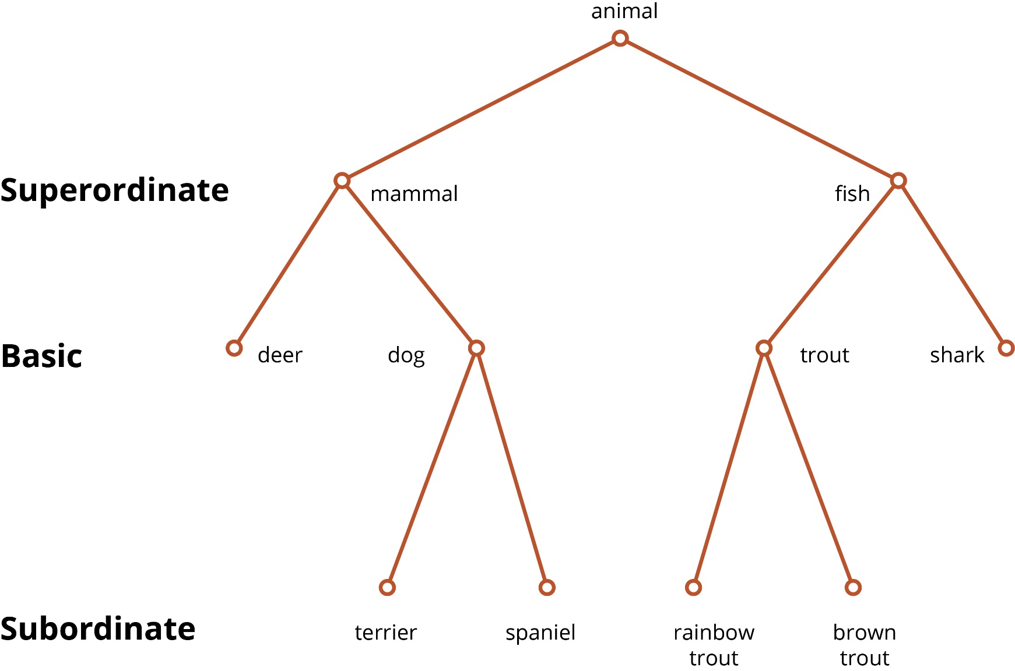
Categorical Hierarchies
Notes:
The purpose of this slide is to discuss and describe categorical hierarchies.
Content:
Superordinate: This level of hierarchy is very broad and general with several basic and subordinate classification encompassing superordinate categories. For example, mammals, reptiles, fish, and birds are all superordinate categories because they have basic levels (e.g., mammals can be a dog, deer, cattle, etc.) and superordinate levels (e.g., dogs can be a chihuahua, dalmation, Labrador, etc.).
Basic: This level of hierarchy is categorized as being not too small or not too big and how it would be labeled in a neutral situation. For example, a coastal black bear is to narrow, a mammal is to big/broad, but a bear is at the basic level. These are the most frequent level of hierarchy and are easier to learn that super- or subordinate levels. Basic levels are also easier to differentiate. Meaning, it is easy to tell the difference between a deer, dog, trout, and shark (i.e., all basic categories) but more difficult to differentiate between cutthroat, brown, rainbow, and grayling trout (i.e., superordinate classifications of trout).
Subordinate: This level of classification is hyper specific and very narrow when compared to basic and superordinate levels. For example, sharks (basic) are fish (superordinate), but there are many different subspecies of sharks (e.g., lemon, great white, hammerhead, reef, etc.).

Slide 15
Overview
Introduction
Fuzzy Categories
Source Typicality
Category Hierarchies
Theories of Concept Representation
Prototype theory
Exemplar theory
Knowledge
Notes:
The purpose of this slide is to provide students with an overview of the material that will be covered during the lecture.

Slide 16
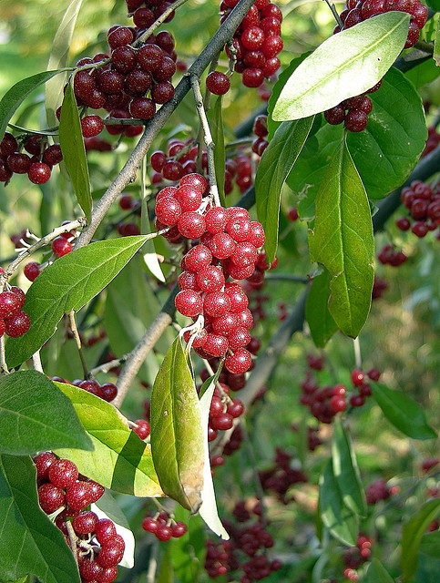
Theories of Concept Representation
Prototype Theory
Summary representation
Weighted features
Exemplar Theory
Close similarity
Notes:
The purpose of this slide is to define and explain the different theories of concept representation.
Content: There are two predominate theories that attempt to explain how we mentally represent concepts in our mind. Namely, Prototype Theory and Exemplar Theory.
(Click): Prototype theory:
(Click): Summary representation
(Click): Weighted features
For this theory, we mentally represent a concept based on summary representation that has weighted features. For example, birds that fly, have feathers and obvious wings, are weighted higher than birds who swim, have small wings and eat fish, and have small feathers.
(Click): Exemplar theory
(Click): Close similarity
Exemplar theory: This theory suggests that we mentally represent a concept based on a comparison to an exemplar. Exemplar meaning, the ideal example of the concept. For instance, what is the exemplar for fruit?
Explanation for the Image: This is an image that depicts the Autumn Olive (https://en.wikipedia.org/wiki/Elaeagnus_umbellate), which doesn’t really look like the typical image of an olive most of us are used to. The module posits a question “Is olive a fruit”? And looking at this image of an olive, one wonders if it perhaps might be fruit, and it turns out, it is.

Slide 17
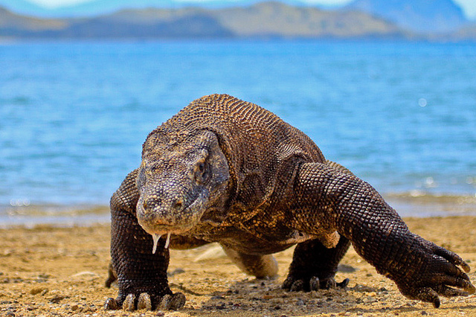
Stop, Think, Discuss
What kind of animal is this?
Notes:
The purpose of this slide is to demonstrate and discuss the two different theories of concept representation (e.g., prototype vs. exemplar theory). Have students apply either theory of concept representation to how they figured out what concept (e.g., type of animal) this was. Explain that for Prototype Theory, you would refer to your summary representations of various categories, then select the most similar (e.g., lizard). For Exemplar Theory, we would compare this to our exemplar for lizards and compare the similarities and dissimilarities.
Content: There are two predominate theories that attempt to explain how we mentally represent concepts in our mind. Namely, Prototype Theory and Exemplar Theory.
Prototype theory: For this theory, we mentally represent a concept based on summary representation that has weighted features. For example, birds that fly, have feathers and obvious wings, are weighted higher than birds who swim, have small wings and eat fish, and have small feathers.
Exemplar theory: This theory suggests that we mentally represent a concept based on a comparison to an exemplar. Exemplar meaning, the ideal example of the concept. For instance, what is the exemplar for fruit? Likely an apple or orange or strawberry. When we see something that is similar (e.g., pineapple) we compare its characteristics to those of the exemplar.

Slide 18
Overview
Introduction
Fuzzy Categories
Source Typicality
Category Hierarchies
Theories of Concept Representation
Knowledge
Notes:
The purpose of this slide is to provide students with an overview of the material that will be covered during the lecture.

Slide 19
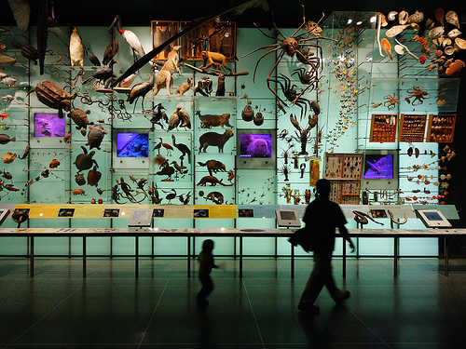
Knowledge
Notes:
The purpose of this slide is to describe how knowledge plays in the formation of categories and context. See the content below to discuss how knowledge applies to categories and context.
Content: Concepts and categories are great ideas, but there needs to be a context to learn concepts and categories. This context is knowledge. That is, concepts and categories by themselves have very little meaning, but when you connect concepts to other knowledge you can create a meaningful connection that is tangible, applicable, and real-world. For example, when learning how to operate a tablet for the first time, you likely drew upon your knowledge of laptops, cell phones, and desktop computers. One aspect of our knowledge of categories and concept is psychological essentialism. Basically, we want to believe that every category has some core essence that causes its features. For example, we often believe (erroneously) that the core essence of a fruit is that it is sweet. This is why we often miscategorize tomatoes or peas as vegetables.

Slide 20

CAT: Student Generated Test Questions
In groups of 3 or 4 people write 3 test questions on material from this module.
Accurately and completely answer each question.
Notes:
Classroom Assessment Technique (CAT): Student-Generated Test Questions
In this CAT students are asked to prepare two or three potential test questions as well as the correct responses for those questions. This allows instructors to consider what was most memorable for students, and can help clarify misunderstandings.
Time: 10-15 minutes
Materials: paper and pen for students
Directions For Instructors:
Break students into teams of 3 or 4 people
Instruct students to write 3 test questions about the information from the module. Students should also write complete and accurate answers to the questions they have written.
Collect the questions and review them either with the whole class or at home. Make note of the topics that are asked about, as these are likely the most memorable for students. Also make note of any misconceptions that students have. You can address these at the end of class during discussion or in the next class period.
Instructions for Students:
(Click): In groups of 3 or 4 people write 3 test questions on material from this module.
(Click): Accurately and completely answer each question.
If you do not conclude with this Classroom Assessment Technique (CAT), it would helpful to use another CAT. It could be in the form of a:
Muddy point
One-minute paper
Background knowledge
What’s the Principle?
Defining features Matrix:
For more information on CATs click here: http://cft.vanderbilt.edu/guides-sub-pages/cats/

Slide 21
Photo Attribution
Slide 1 | Photo Credit: Paleontologist dog loves bones TheGiantVermin https://www.flickr.com/photos/39038071@N00/11720216275/ https://creativecommons.org/licenses/by-nc-nd/2.0/
Slide 3 | Photo Credit: Baby zebra taking it's first steps Jules Holleboom https://www.flickr.com/photos/holleboom/2224354350 https://creativecommons.org/licenses/by-nc-sa/2.0/ Photo Credit: Fighting giraffes in Ithala Game Reserve, northern KwaZulu-Natal, South Africa Luca Galuzzi https://en.wikipedia.org/wiki/Giraffe#/media/File:Giraffe_Ithala_KZN_South_Africa_Luca_Galuzzi_2004.JPG https://creativecommons.org/licenses/by-sa/2.5/ Photo Credit: Zebra in South Africa Jack Zalium https://commons.wikimedia.org/wiki/File:Zebra_in_South_Africa.jpg#/media/File:Zebra_in_South_Africa.jpg https://creativecommons.org/licenses/by/2.0/ Photo Credit: Giraffe mvdsande https://pixabay.com/en/giraffe-long-neck-zoo-animal-1124451/ https://creativecommons.org/publicdomain/zero/1.0/deed.en Photo Credit: Chester Zoo Nigel Swales https://www.flickr.com/photos/28946988@N07/22076530742/ https://creativecommons.org/licenses/by-sa/2.0/
Slide 5 | Photo Credit: Office of floating shelves Jeremy Levine https://www.flickr.com/photos/jeremylevinedesign/3589652595 https://creativecommons.org/licenses/by-nc-nd/2.0/
Slide 6 | Photo Credit: My Work Desk David Joyce https://www.flickr.com/photos/deapeajay/2597109669 https://creativecommons.org/licenses/by-sa/2.0/
Slide 10 | Photo Credit: Macaroni penguin Butterfly voyages https://en.wikipedia.org/wiki/Crest_(feathers)#/media/File:Eudyptes_chrysolophus4_(South_Georgia).jpg https://creativecommons.org/licenses/by-sa/3.0/ Photo Credit: Guianan cock-of-the-rock Almir Cândido de Almeida https://en.wikipedia.org/wiki/Sexy_son_hypothesis#/media/File:Guianan_Cock-of-the-rock_(Rupicola_rupicola).jpg https://creativecommons.org/licenses/by/2.0/ Photo Credit: Baby platypus LandLearn NSW https://www.flickr.com/photos/landlearnnsw/3943667382 https://creativecommons.org/licenses/by-nc-sa/2.0/
Notes:
Photo Attribution Slide

Slide 22
Photo Attribution
Slide 12 | Photo Credit: Painting Kid Jim Pennucci https://commons.wikimedia.org/wiki/File:Painting_kid.jpg#/media/File:Painting_kid.jpg http://creativecommons.org/licenses/by/2.0/ Photo Credit: Raven in Winter Doug Brown https://www.flickr.com/photos/dougbrown47/15752259640 https://creativecommons.org/licenses/by-nc-sa/2.0/ Photo Credit: Adult female and infant wild chimpanzees feeding on Ficus sur Alain Houle https://simple.wikipedia.org/wiki/Chimpanzee#/media/File:Adult_female_and_infant_wild_chimpanzees_feeding_on_Ficus_sur.jpeg https://creativecommons.org/licenses/by/4.0/
Slide 16 | Photo Credit: Autumn olive in fruit Jenn Forman Orth https://www.flickr.com/photos/urtica/55331880 https://creativecommons.org/licenses/by-nc-sa/2.0/
Slide 17 | Photo Credit: The Komodo Dragon Adhi Rachdian https://www.flickr.com/photos/rachdian/5418187901 https://creativecommons.org/licenses/by/2.0/
Slide 19 | Photo Credit: Biodiversity Dominik https://www.flickr.com/photos/ogil/2540634421 https://creativecommons.org/licenses/by-nc-nd/2.0/
Slide 20 | Photo Credit: Illustrated silhouette of a black cat nehtaeh79 http://www.freestockphotos.biz/stockphoto/16624 http://creativecommons.org/publicdomain/zero/1.0/
Notes:
Photo Attribution Slide

